Slide 1

Introduction to RaBIDS
Where
When

Slide 2
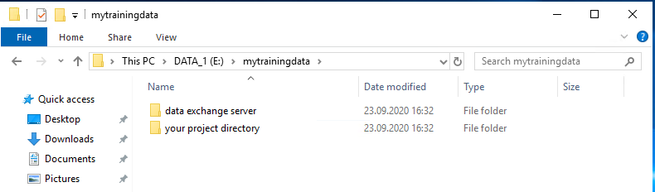
Data structure
Data exchange directory = hobbes
Your project directory = local project directory for analysis and self-archiving

Slide 3
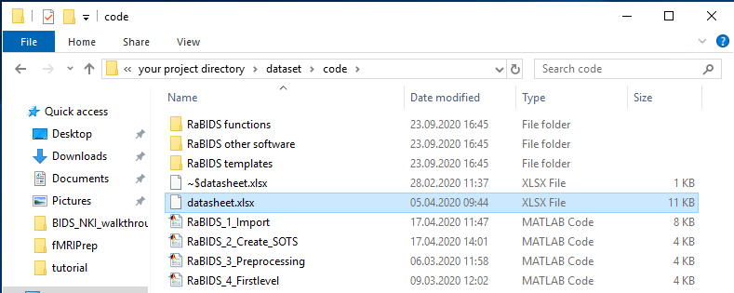
Data structure
Automated Import requires to fill in the datasheet.xlsx file.
This file contains descriptive information which is used by the matlab-based programs to navigate through paths, access subject data, and to interpret fMRI and logfile data.

Slide 4
Data structure
Automated Import requires to fill in the datasheet.xlsx file.
This file contains descriptive information which is used by the matlab-based programs to navigate through paths, access subject data, and to interpret fMRI and logfile data.

Slide 5
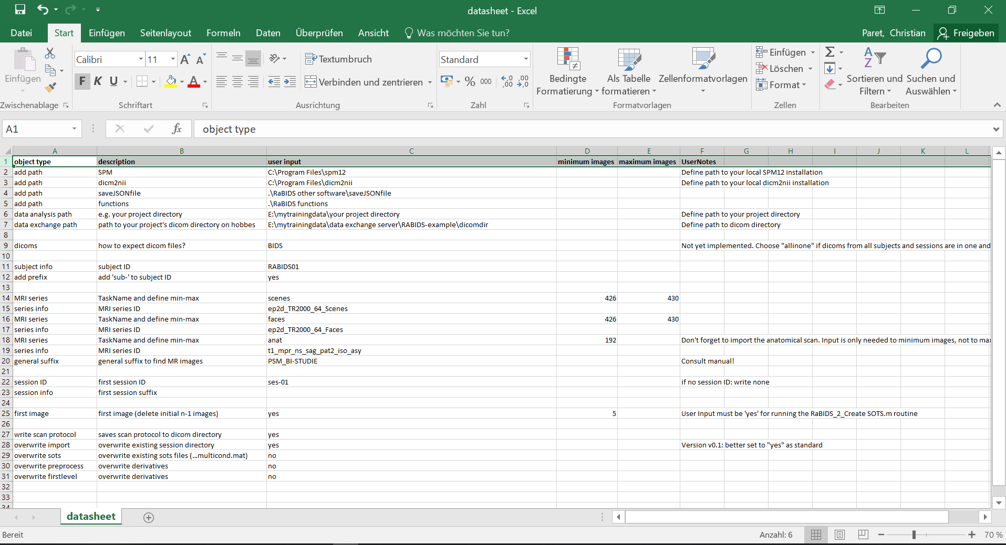
The datasheet-file

Slide 6

Vielen Dank für Ihre Aufmerksamkeit
www.zi-mannheim.de
info@zi-mannheim.de

